Slide 1
Introduction

Slide 2

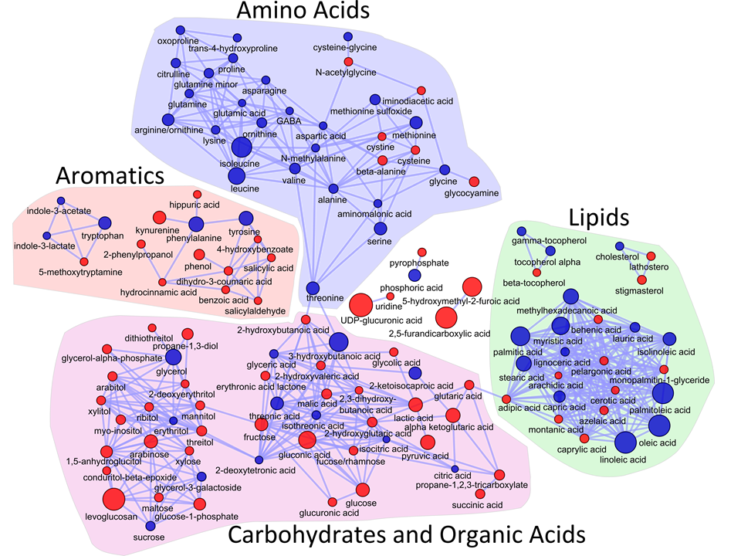
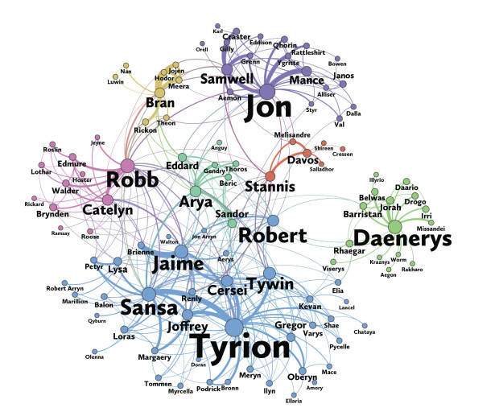
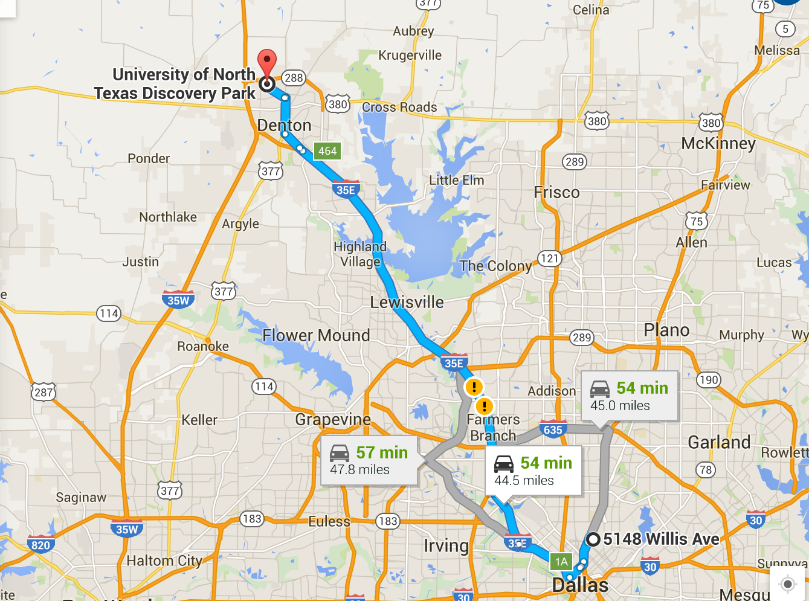
Graphs
Graphs are defined as
A set ofvertices {1,2,3}
And a set of edges (vertex pairs) {(1,2), (1,3)}
Graphs are used to represent relations or interactions in a system
Many applications
1
2
3
Notes:
2 sets – vertices and edges
Graphs represent a lot of different things – Ex, Biological networks, social networks, maps, and Citations.
Can be stories (They do not need to be real).

Slide 3
Uses of Graph Theory
Determining optimal path for robots to scan
Identifying super spreaders in a social network
Calculating the shortest route between two cities
Finding the best matches in a recruiting site
Assigning optimal number of classrooms
Creating recommendation for customers
Designing code encryption
…….
Notes:
It can be used anywhere which has relations.

Slide 4
Properties of Graphs
Vertex Set 𝕍 ={A,B,C,D,E,F}; 𝕍is the vertex set
Edge Set 𝔼 ={(A,B),(B,C),(B,D),(C,E), (C,F),(D,E),(E,F)}; 𝔼 is the edge set
In an undirected graph an edge between vertices (A,B) implies there is also an edge between vertices (B,A)
Neighbors of a vertex are vertices that share an edge with it. A vertex and its neighbor are adjacent to each other. N(v) is the set of neighbors of v.
Neighbors of B are A,C,D
C is a neighbor of B but not of D
Degree of a vertex is the number of neighbors; D(v) is the degree of v; D(v)=|N(v)|
Degree of A is 1
Degree of B is 3
Clustering coefficient of a vertex measures how tightly a vertex is connected to its neighbors
CC(v) = number of edges in subgraph induced by N(v)/total possible edges in subgraph induced by N(v)
CC(F)=1/1=1
CC(C)=1/3
A
B
C
F
D
E

Slide 5
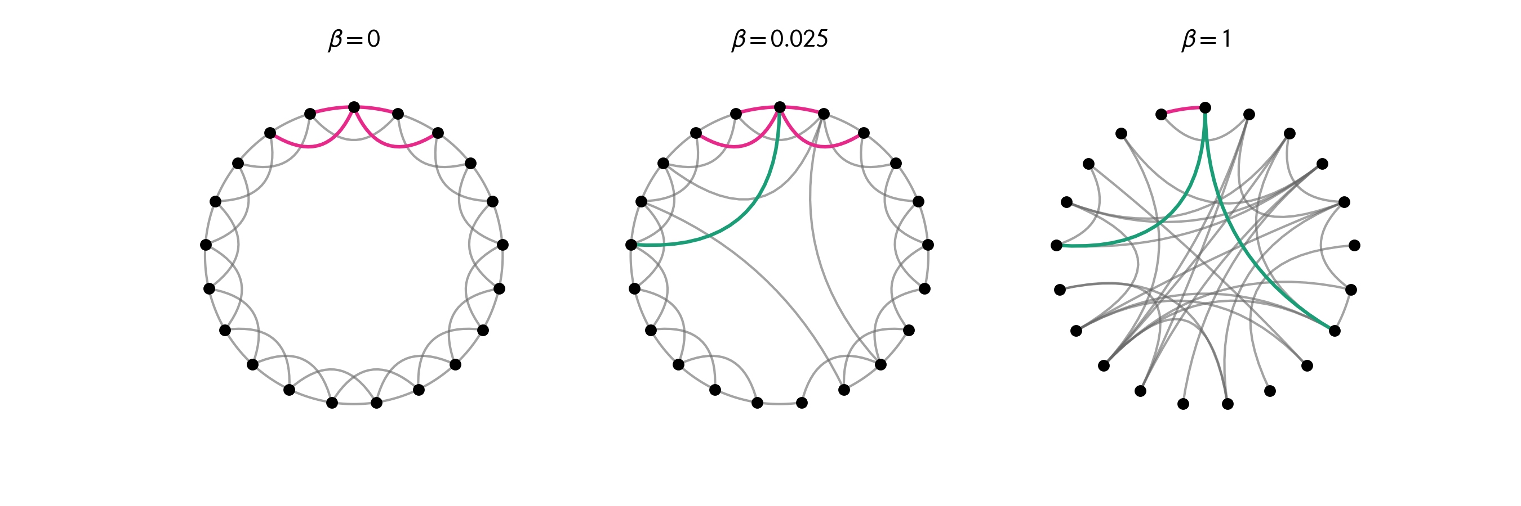
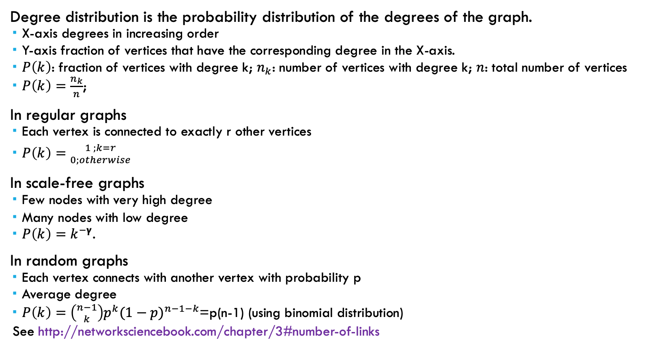
Degree Distribution
Degree distribution is the probability distribution of the degrees of the graph.
X-axis degrees in increasing order
Y-axis fraction of vertices that have the corresponding degree in the X-axis.
$P\left(k\right)$: fraction of vertices with degree k; $n_{k}$: number of vertices with degree k; $n$: total number of vertices
$P\left(k\right)=\frac{n_{k}}{n}$;
In regular graphs
Each vertex is connected to exactly r other vertices
$P\left(k\right)={1 ;k=r \atop 0;otherwise}$
In scale-free graphs
Few nodes with very high degree
Many nodes with low degree
$P\left(k\right)=k^{−γ}$.
In random graphs
Each vertex connects with another vertex with probability p
Average degree
$P\left(k\right)=\left({n−1 \atop k}\right)p^{k}{(1−p)}^{n−1−k}$=p(n-1) (using binomial distribution)
See http://networksciencebook.com/chapter/3#number-of-links
Watts Strogatz model: From regular, to scale free, to random. Rewiring by changing 𝛃.
https://pypi.org/project/smallworld/
Watts, D. J., & Strogatz, S. H. (1998). Collective dynamics of ‘small-world’networks. nature, 393(6684), 440.
https://chih-ling-hsu.github.io/2020/05/15/watts-strogatz

Slide 6
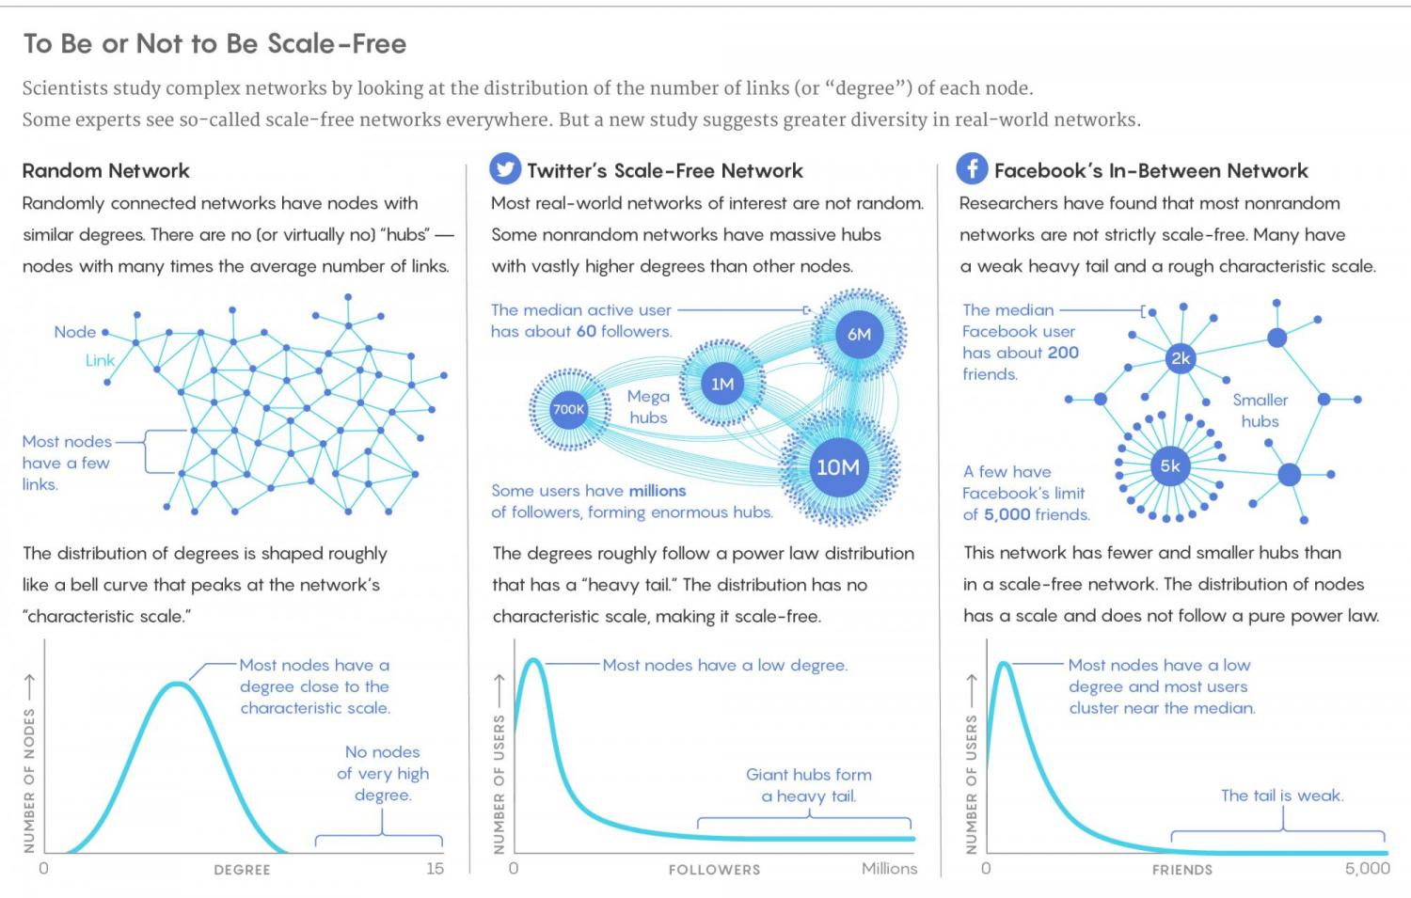
Image from https://www.colorado.edu/biofrontiers/2018/02/15/scant-evidence-power-laws-found-real-world-networks

Slide 7
Properties of Graphs
A path is a sequence of vertices (v1,v2,v3,..vn), such that consecutive vertices in the sequence have an edge between them.
(B,C,E,F) is a path
(B,C,D) is not a path
The length of a path is the number of edges in the path
Length of path(B,C,E,F) is 3
A cycle is a path where the beginning and end vertices are the same; v1=vn
(B,C,E,D,B) is a cycle of length 4
(C,E,F) is a cycle of length 3
A graph is connected if there is a path between any two vertices in the graph
A
B
C
F
D
E

Slide 8
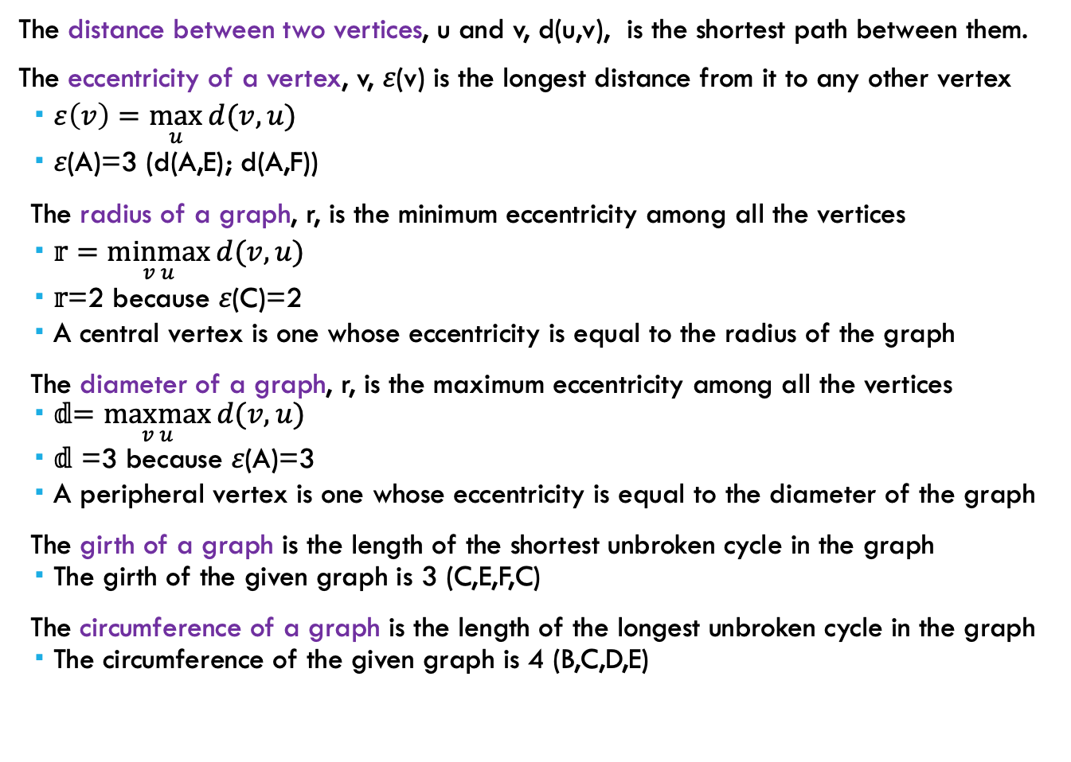
Properties of Graphs
The distance between two vertices, u and v, d(u,v), is the shortest path between them.
The eccentricity of a vertex, v, 𝜀(v) is the longest distance from it to any other vertex
$ε\left(v\right)=\max_{u}{d(v,u)}$
𝜀(A)=3 (d(A,E); d(A,F))
The radius of a graph, r, is the minimum eccentricity among all the vertices
$\text{𝕣}=\underset{v u}{minmax}{d(v,u)}$
𝕣=2 because 𝜀(C)=2
A central vertex is one whose eccentricity is equal to the radius of the graph
The diameter of a graph, r, is the maximum eccentricity among all the vertices
𝕕$=\underset{v u}{maxmax}{d(v,u)}$
𝕕 =3 because 𝜀(A)=3
A peripheral vertex is one whose eccentricity is equal to the diameter of the graph
The girth of a graph is the length of the shortest unbroken cycle in the graph
The girth of the given graph is 3 (C,E,F,C)
The circumference of a graph is the length of the longest unbroken cycle in the graph
The circumference of the given graph is 4 (B,C,D,E)
A
B
C
F
D
E

Slide 9
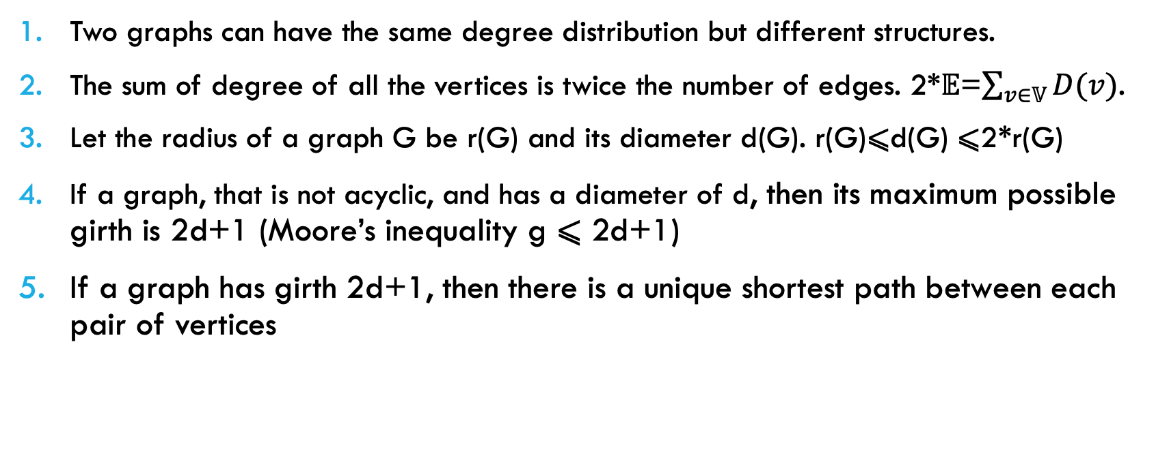
In Class Exercise: Prove the Following
Two graphs can have the same degree distribution but different structures.
The sum of degree of all the vertices is twice the number of edges. 2*𝔼=$\sum_{v∈𝕍}{D(v)}$.
Let the radius of a graph G be r(G) and its diameter d(G). r(G)⩽d(G) ⩽2*r(G)
If a graph, that is not acyclic, and has a diameter of d, then its maximum possible girth is 2d+1 (Moore’s inequality g ⩽ 2d+1)
If a graph has girth 2d+1, then there is a unique shortest path between each pair of vertices

Slide 10
Directed GRAPHS
In a directed graph an edge from vertex u to v, does not imply that there will be an edge from v to u.
In-degree of a vertex is the number of edges pointing to it. A vertex that has only indegree is a sink
In-degree of C is 2
A is a sink
Out-degree of a vertex vertex is the number of edges pointing away from it. A vertex that has only out-degree is a source
Out-degree of C is 1
B is a source
A directed graph is strongly connected if there is a path from every vertex to every other vertex while maintaining the direction of the edges
The subgraph induced by vertices C,E,F is strongly connected
A directed graph is weakly connected if there is a path from every vertex to every other vertex while ignoring the direction of the edges
The given graph is weakly connected
A
B
C
F
D
E

Slide 11
Directed AcycliC Graphs (DAGs)
Directed acyclic graphs (DAGs) are directed graphs with no cycles
A topological ordering on a DAG is a sequence of vertices, such that if there is an edge from u to v, then u appears before v in the sequence
To find topological ordering
While there exists sources
Append all sources of G in the sequence
Remove all sources of G to create new graph H
G=H
In this algorithm, we visit each vertex and edge exactly once, so the complexity is O(V+E)
A
B
C
F
D
E

Slide 12
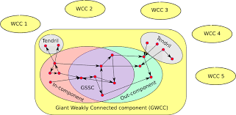
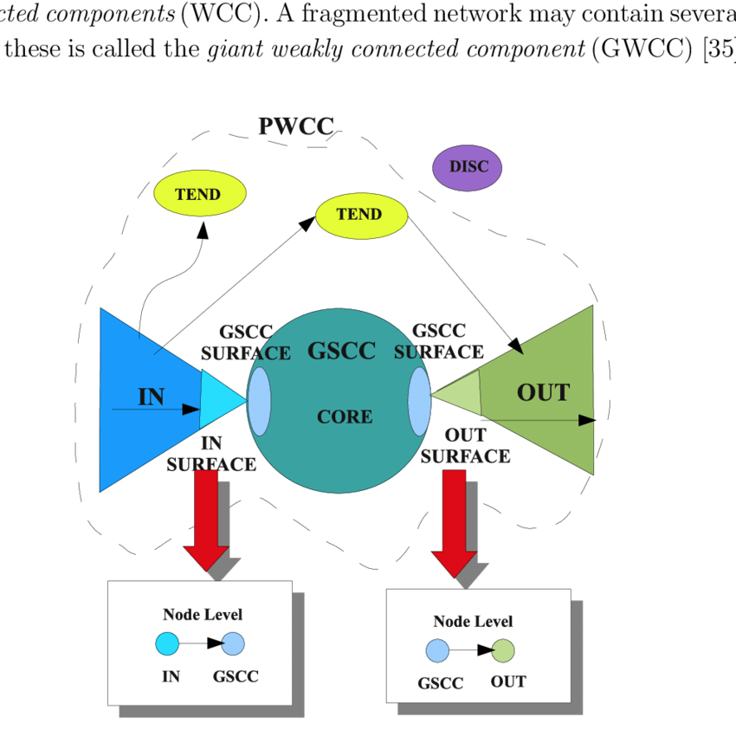
GiAnt Components
In real world undirected networks, there generally exists one giant connected component and several smaller components.
The giant component is usually more than 90% of the vertices
In directed graphs there is typically one large strongly connected component and many smaller components. Each strongly connected component has an in-component and out component (bow tie model)

Slide 13
Strongly Connected Components
1
A
1
A
1
B
2
4
5
B
C
C
F
6
4
F
1
3
E
4
4
D
E
D
Tarjan’s Algorithm (1972): [paraphrased]
Do DFS on the graph
Assign index(v) to vertices in the order they are visited
The edges used in DFS are tree edges
Rest are cross edges
Assign low(v) to lowest vertex reachable via tree edges and at most one cross edge
Vertices with same low(v) are in the same SCC

Slide 14
CLIQUEs /COMPLETE GRAPHS
A clique or a complete graph is a graph where every pair of vertices have an edge between them.
A clique of n vertices is denoted as Kn
A complement of a graph G is the graph H, such that there exists an edge between vertices u and v in H, if and only if there is no edge between u and v in G.
Union of the edges of G and H forms a clique.
Blue lines graph G, pink lines graph H. Together a clique
A tournament is a directed graph in which every pair of vertices have a directed edge.
Used in computational social choice to determine outcome of votes
A tournament is transitive if
given a → b and b → c; implies a → c
B
C
B
C
D
A
D
A
B
C
D
A

Slide 15
Computational Social Choice
Computational social choice theory is concerned with the design and analysis of methods for collective decision making.
Majority Preference Through Paired Comparison (Marquis de Condorcet 1780)
Given a set of X candidates. Each candidate is represented by a vertex
There is an edge from vertex a to vertex b, if more voters prefer a to b
If we create a paired voting among every candidate then we have a tournament
If the tournament is transitive, then there is a Hamiltonian path in the graph
The candidates can be placed in a linear order of their choice
The final destination vertex is the Concordet winner
What can we conclude if the tournament is strongly connected ?
Tournaments in computational social choice: recent developments. W. Suksompomg (https://www.ijcai.org/proceedings/2021/0626.pdf)

Slide 16
In Class Exercise: Prove the Following
A DAG will never be strongly connected
A transitive tournament is a DAG
Every tournament has at least one Hamiltonian path

Slide 17
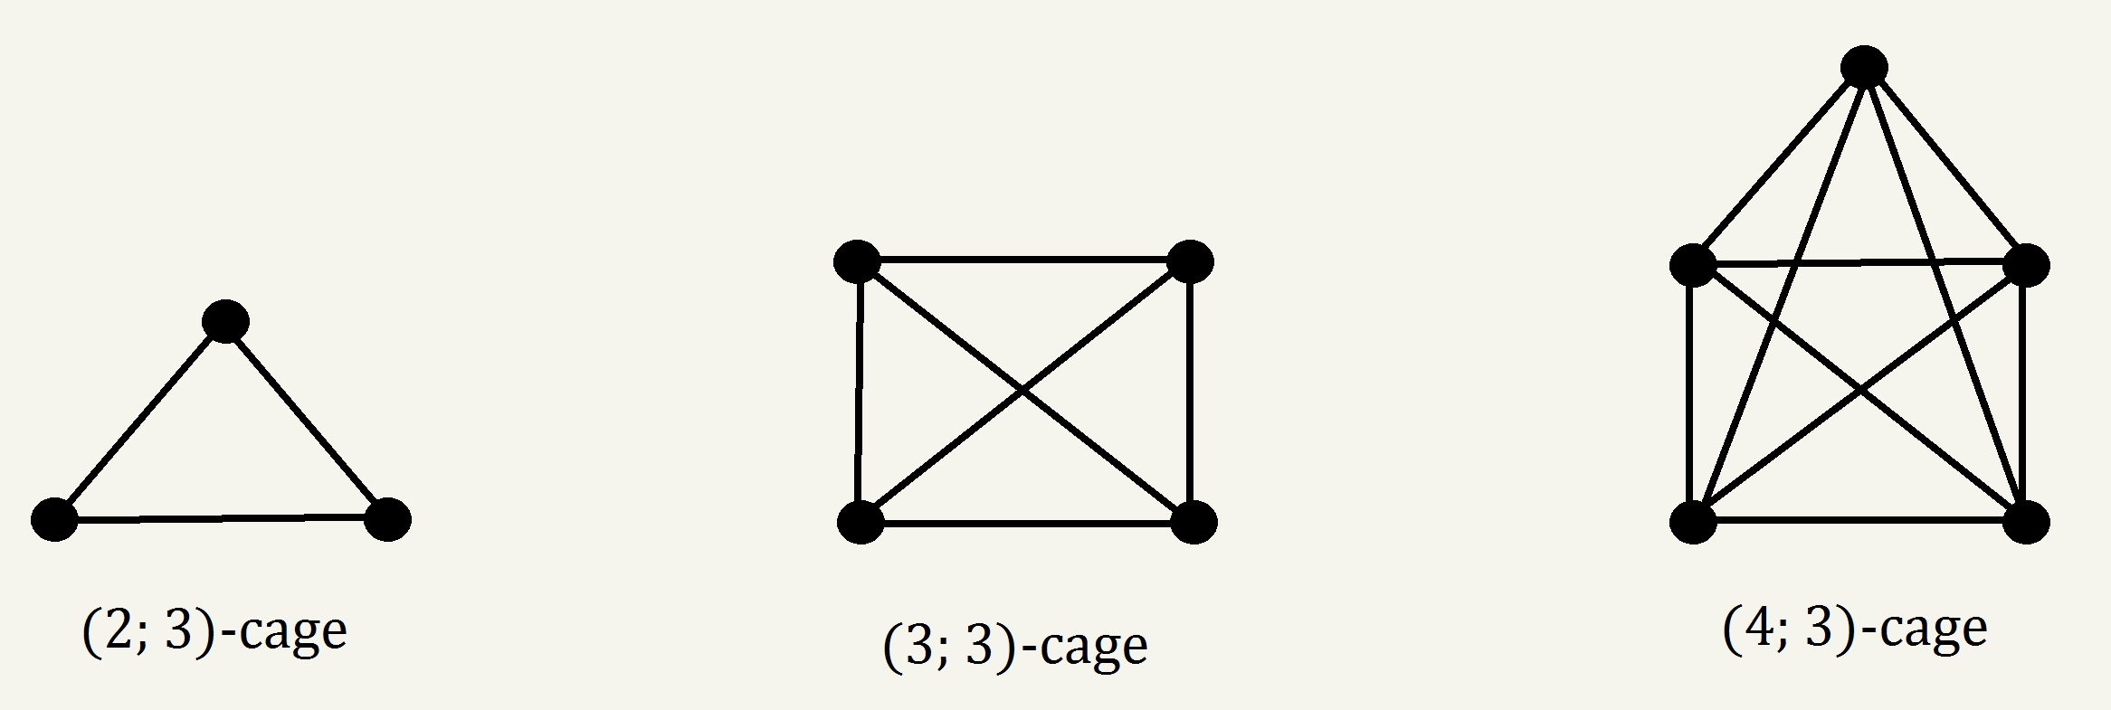
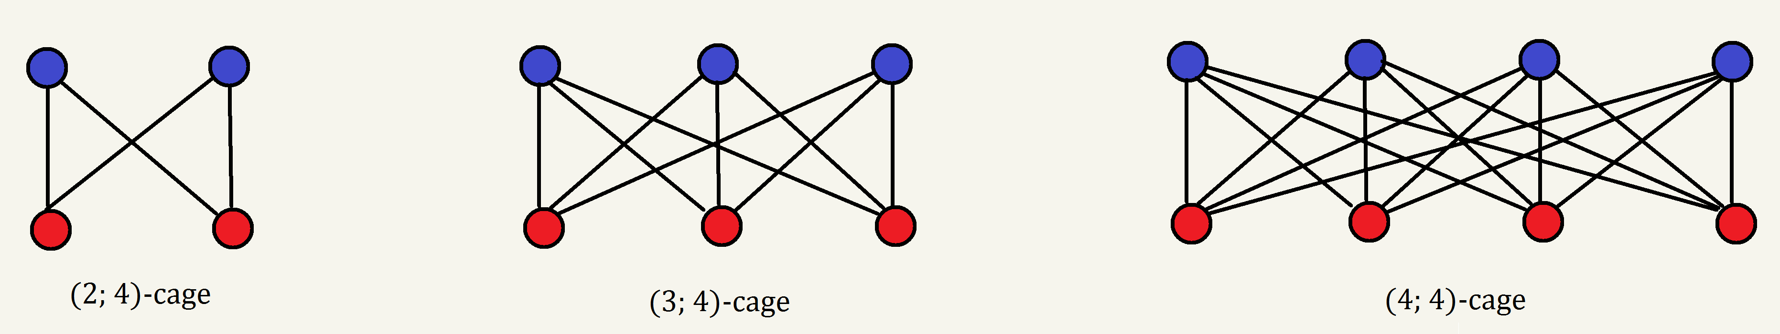
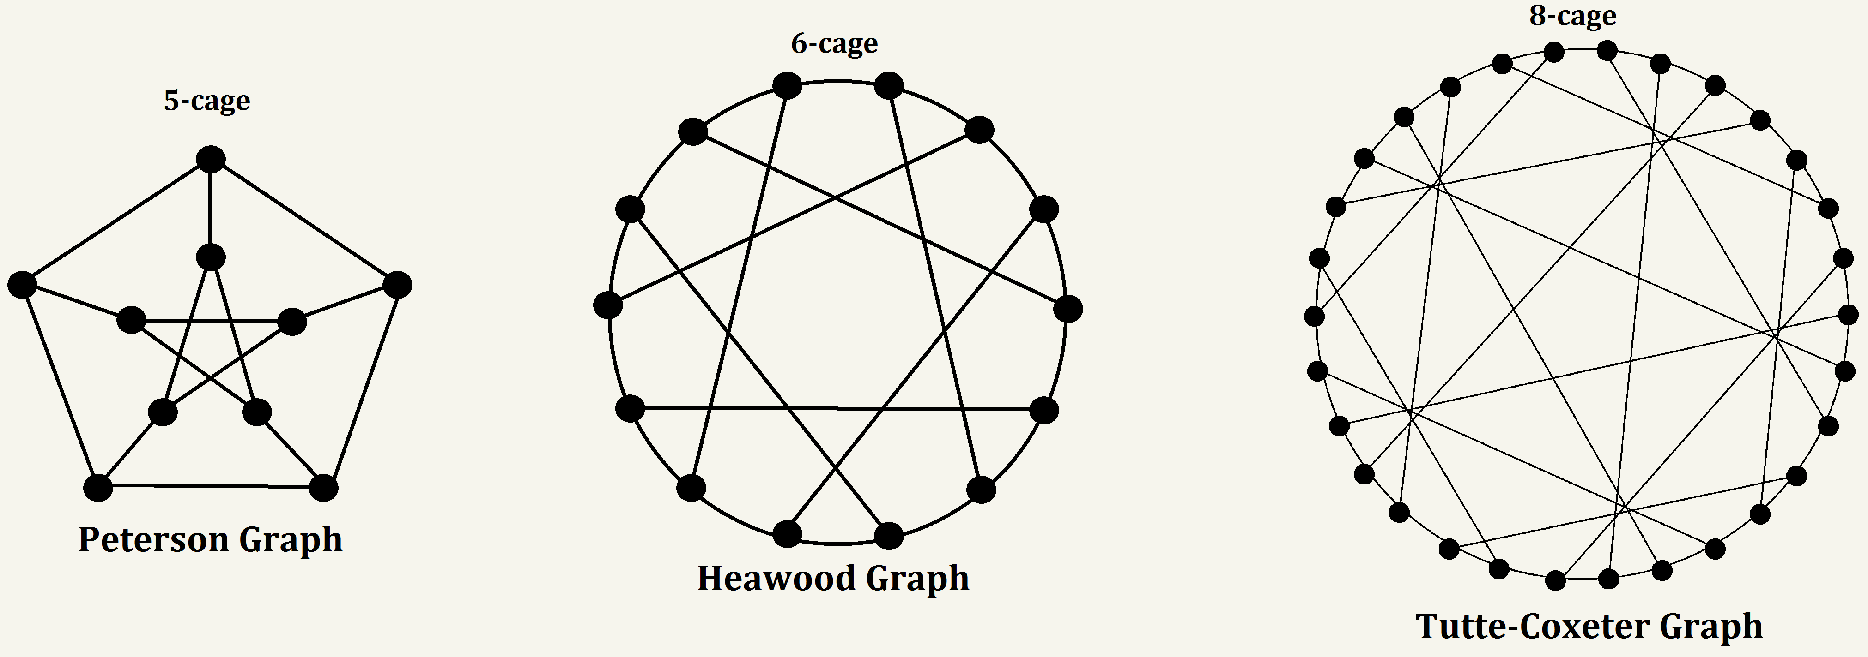
Regular Graphs
A regular graph is where every vertex has the same degree. In a k-regular graph, every vertex has degree k
Moore graphs are graphs with diameter d and girth 2d+1
Moore graphs are regular
Any Moore graph with girth 5 must have degree 2, 3, 7, or 57.
A (r,g) cage is a r-regular graph with girth g, that can be constructed with the smallest number of vertices
A cage graph is a generalization of Moore graphs
Images from https://stetsonbosecker.wordpress.com/2015/03/18/cages/

Slide 18
Moore Graphs Are Regular: Proof
In a Moore graph the girth (smallest cycle) is 2d+1 (d=diameter)
Thus between any two vertices there is a unique shortest path
Let two vertices (u and v) be at distance d from each other. Let the set of neighbors of these vertices be N(u) and N(v) respectively.
We show that there is a bijection (one to one correspondence) among the elements in N(u) and N(v). If this is true then |N(u) |= |N(v)|
Let x ∈ N(u). The distance from x to v will be exactly d
Let y ∈ N(v), be the vertex in the path x ↝v
Because there is unique path between any two vertices, thus no other neighbor of v will be in the path
Thus x and y have one to one correspondence. Similar proof for all other neighbors of u and v
Thus for any two vertices in a circle of length 2d+1 we can prove that their degrees are equal
If vertex a is not in the circle, then there exists vertex b in the circle that is d distance away from a. Thus their degrees are the same.

Slide 19
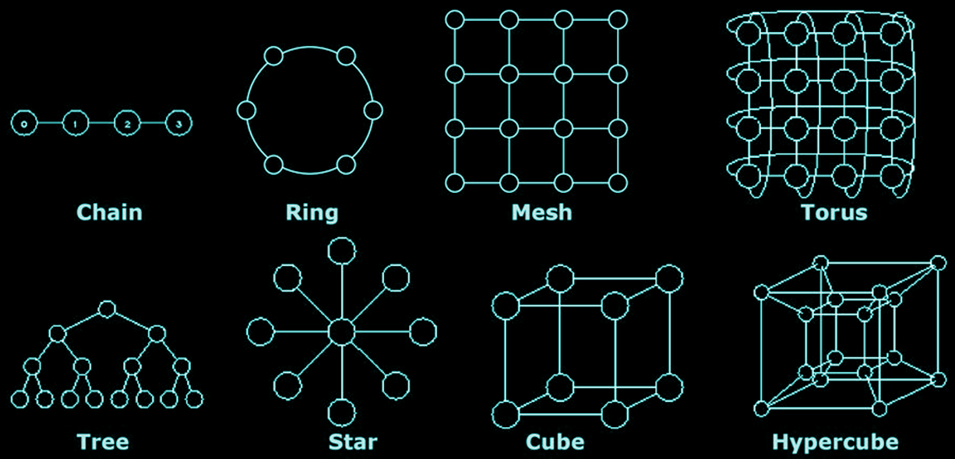
Network Topology
Consider a set of computer nodes that are connected to each other to form a high performance computing system. What should be the topology/structure of the network
Should send messages quickly, so we need small distance between nodes
Should be resilient in that at least half of its nodes must fail before it is disconnected
Should be scalable such that new nodes can be added without to much change
Should be sparse in that number of edges should not significantly increase with number of nodes
Should have alternate shortest paths between nodes
Images from https://www.cs.iusb.edu/~danav/teach/b424/b424_24_networks.html

Slide 20
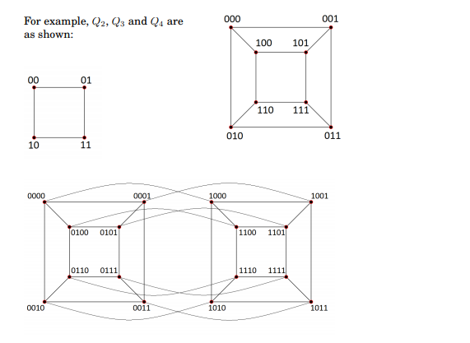
Hypercube
A hypercube with 2^{n} nodes has
Degree of each node is n (log of number of vertices)
Diameter is n
At least 2^{n-1} nodes have to be deleted to disconnect the vertices
Number of edges is 2^{n-1}n
Number of alternate paths between two vertices is 2^{d-1} where d is the distance between the vertices
Nodes in a hypercube are labeled using Gray code
There is exactly one bit changing between adjacent vertices
Easier to determine the route between nodes

Slide 21
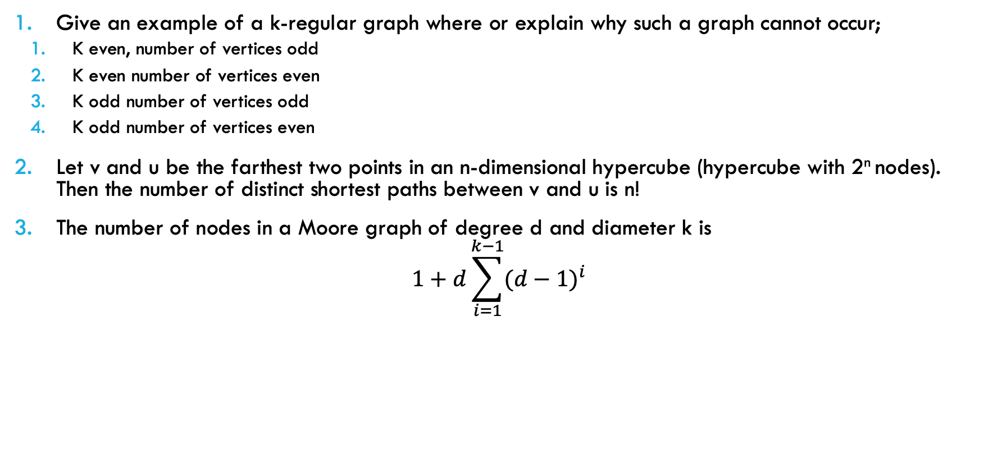
In Class Exercise: Prove the Following
Give an example of a k-regular graph where or explain why such a graph cannot occur;
K even, number of vertices odd
K even number of vertices even
K odd number of vertices odd
K odd number of vertices even
Let v and u be the farthest two points in an n-dimensional hypercube (hypercube with 2^{n} nodes). Then the number of distinct shortest paths between v and u is n!
The number of nodes in a Moore graph of degree d and diameter k is
$$1+d\sum_{i=1}^{k−1}{{(d−1)}^{i}}$$

Slide 22
Graph Representations
D
A
D
A
Adjacency matrix (two-dimensional array)
Let G=(V,E) be a graph with n vertices.
The adjacency matrix of G is a two-dimensional n×n array, say adj_mat
If the edge (vi, vj) is in E(G), adj_mat[i][j]=1
If there is no such edge in E(G), adj_mat[i][j]=0
The adjacency matrix for an undirected graph is symmetric; the adjacency matrix for a digraph need not be symmetric
C
B
C
B
(a) G1
( undirected graph )
(b) G2
( directed graph )
A
B
C
D
A
B
C
D
A
0 1 1 1
1 0 0 1
1 0 0 1
1 1 1 0
A
0 1 0 0
0 0 0 0
1 1 0 0
1 1 0 0
B
B
M =
M =
C
C
D
4 × 4
D
Symmetric matrix
Uncertain symmetric matrix

Slide 23
Adjacency list
D
A
D
A
C
B
C
B
(a) G1
( undirected graph )
(b) G2
( directed graph )
List[]
List[]
List[A]
B
C
D
List[A]
B
List[B]
A
D
List[B]
List[C]
A
D
List[C]
A
B
List[D]
B
C
D
List[D]
A
B

Slide 24
GRAPH AS A Matrix
 | A | B | C | D | E | F
A | 1 | 1 | 0 | 0 | 0 | 0
B | 1 | 1 | 1 | 1 | 0 | 0
C | 0 | 1 | 1 | 0 | 1 | 1
D | 0 | 1 | 0 | 1 | 1 | 0
E | 0 | 0 | 1 | 1 | 1 | 1
F | 0 | 0 | 1 | 0 | 1 | 1
A
B
C
F
D
E
A graph can be represented as a matrix, called an adjacency matrix.
If there is an edge between two vertices then the corresponding cell will contain 1 or the weight of the edge
Diagonals are generally given as 1
All other cells are 0

Slide 25
MATRIX Operations for Graphs
 | A | B | C | D | E | F
A | 1 | 1 | 0 | 0 | 0 | 0
B | 1 | 1 | 1 | 1 | 0 | 0
C | 0 | 1 | 1 | 0 | 1 | 1
D | 0 | 1 | 0 | 1 | 1 | 0
E | 0 | 0 | 1 | 1 | 1 | 1
F | 0 | 0 | 1 | 0 | 1 | 1
 | A | B | C | D | E | F
A | 1 | 1 | 0 | 0 | 0 | 0
B | 1 | 1 | 1 | 1 | 0 | 0
C | 0 | 1 | 1 | 0 | 1 | 1
D | 0 | 1 | 0 | 1 | 1 | 0
E | 0 | 0 | 1 | 1 | 1 | 1
F | 0 | 0 | 1 | 0 | 1 | 1
 | A | B | C | D | E | F
A | 2 | 2 | 1 | 1 | 0 | 0
B | 2 | 4 | 2 | 2 | 2 | 1
C | 1 | 2 | 4 | 2 | 3 | 3
D | 1 | 2 | 2 | 3 | 2 | 1
E | 0 | 2 | 3 | 2 | 4 | 3
F | 0 | 1 | 3 | 1 | 3 | 3
A
B
C
X
=
F
D
E

Slide 26
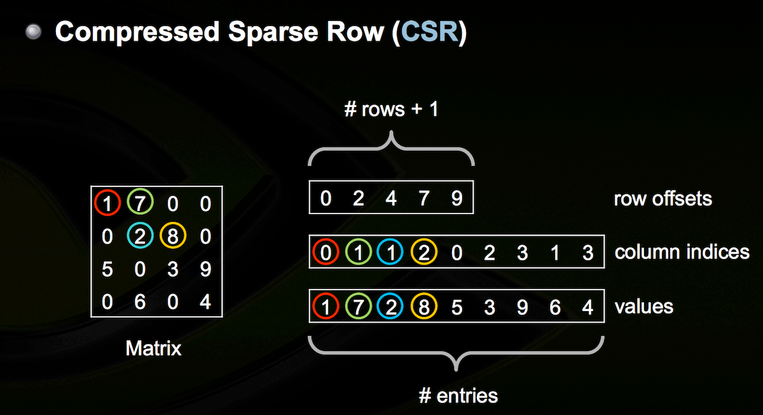
STORING SPARSE MATRICES
Image from https://dziganto.github.io/Sparse-Matrices-For-Efficient-Machine-Learning/

Slide 27
ANALYZING LARGE GRAPHS
Many real world networks are typically very large
Facebook has over a billion users
We need parallel computing to process them efficiently
Top 500 Supercomputer List
https://www.top500.org/lists/top500/2021/11/
Lists the top 500 supercomputer in the world
(based on number of FLOPS)
Updated in June and November
What else can we measure other than performance?
Is this high performance achievable for all kinds of problems ?

Slide 28
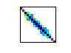
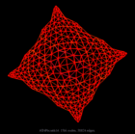
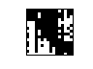
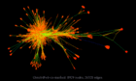
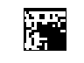
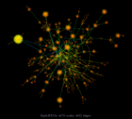
APPLICATIONS
Structured Graphs
Partial Differential Equations
Unstructured Graphs
Data Analysis
Unstructured, Dynamic
Social Networks
Images obtained from University of Florida Sparse Matrix Collection

Slide 29
NETWORK REPOSITORIES
Network Reository
http://networkrepository.com/
SuiteSparse Matrix Collection
https://sparse.tamu.edu/
Colorado Index of Complex Networks( ICON)
https://icon.colorado.edu/#!/
Stanford Network Analysis Project (SNAP)
http://snap.stanford.edu/
Exploratory Social Network Analysis with Pajek
http://vlado.fmf.uni-lj.si/pub/networks/data/esna/default.htm
There are several others. There are also datasets, such as gene correlation data in NCBI, that are not explicitly in network form but can be modeled as networks.
Notes:
These are not all

Slide 30
ANALYSIS SOFTWARE
NetworkX
https://github.com/NetworkX/NetworkX
Cytoscape
https://cytoscape.org/
Gephi
https://gephi.org/
Jung
http://jung.sourceforge.net/
Boost Graph Library
https://www.boost.org/doc/libs/1_66_0/libs/graph/doc/index.html
NodeXL
https://www.smrfoundation.org/nodexl/
igraph
https://igraph.org/redirect.html

Slide 31
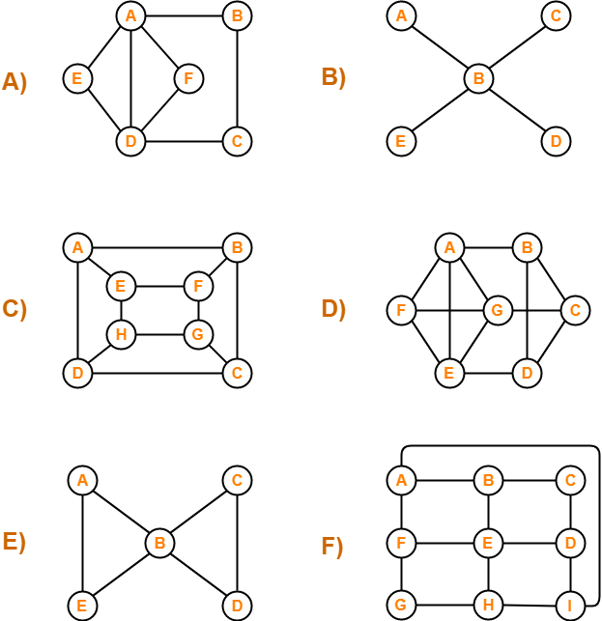
Can You Draw These Figures Without Lifting the PENCIL FROM THE PAPER

Slide 32

Seven Bridges of Konigsburg
The city of Königsberg was set on both sides of the Pregel River, and included two large islands which were connected to each other and the mainland by seven bridges.
Is there a walk through the city that would cross each bridge once and only once.
The islands could not be reached by any route other than the bridges, and every bridge must have been crossed completely every time

Slide 33
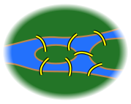
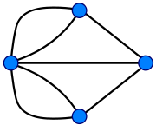
Seven Bridges of Konigsburg
The Konigsburg bridge problem is one of the first problem to be solved using graph theory
Solved by Euler in 1735
Mathematically showed that such a walk cannot exist
Eulerian Path: A path in the graph that visits every edge exactly once
For a solution to exist, no more than two vertices can have odd number of edges coming out of them. Why ?

Slide 34
FLUERY’S ALGORITHM (1883)
B
C
Odd vertices C and D
Choose C as starting vertex
E
A
D
Fluery’s algorithm to find the Eulerian path
Check that there are at most 2 vertices with odd degrees
If there are vertices with odd degrees, start with either of them
Let starting vertex be v
Remove an edge from v-u, such that the graph is not disconnected
If no such edge possible, remove any of the remaining edges.
Mark u as the starting vertex
Continue until no edges remaining
The order in which edges are removed gives the Eulerian path
B
C
B
C
E
E
A
D
A
D
B
C
B
C
E
E
A
D
A
D
B
C
B
C
E
E
A
D
A
D

Slide 35
FLUERY’S ALGORITHM
Fluery’s algorithm requires going through all the edges, so complexity O(E)
However for each edge removal, we have to check whether that edge will disconnect the graph. Complexity of that algorithm is O(E). So we need to run an O(E) algorithm at each edge removal. Thus total complexity is O(E²)
Faster algorithm by Heirholzer (1873) is O(E)

Slide 36
Robotic PATHS
Given the layout of the room, the doors are marked by red lines
Is there a path that will visit each door exactly once ?
Is there a path that visits each room exactly once ?
E
A
D
B
C

Slide 37
WeekLy TASKS
Every student is expected to work on the tasks. You can work in groups. For the tasks there is no limit to the number of people in the group. I will call upon students to come and discuss what they have done.

Slide 38
TASKS for NEXt WEEK
Prove that if a tournament is transitive then it has exactly one Hamiltonian path.
Prove that the maximum distance between two points in a n-dimensional hypercube is logn
Use the code in https://pypi.org/project/smallworld/ to replicate the Watts Strogatz experiment. Try it with 𝜷=0,.001.0025, .25,.5,1. Print out the graphs obtained and bring to class to share.
Test out any two of the network repositories. Be prepared to demonstrate in class on how to download data
Test out any two of the analysis software. Bring screen shots to explain in class how to get started on them.
Show how to solve the 4-cube puzzle

Slide 39
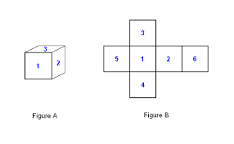
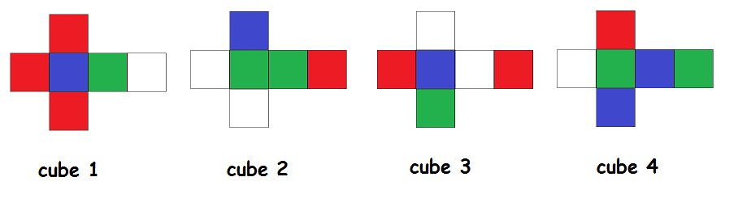
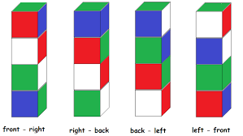
FOUR CUBe PUZZLE
You are given four cubes. Each of the six sides of the cubes is colored with one of the four colors; Red, Blue, White and Green. Figure 1 shows the color assignment to the faces of each cube. The goal is to stack the cubes in such a way that each color appears exactly once on each of the four sides of the tower.

